Slide 1


e-Conductor
Group 09
(Next Level of Sri Lankan Public Transport)
Department of Computer Engineering
Faculty of Engineering
University of Peradeniya
Sri Lanka

Slide 2
e-Conductor
Group 09
(Next Level of Sri Lankan Public Transport)
Department of Computer Engineering
Faculty of Engineering
University of Peradeniya
Sri Lanka

Slide 3



e-Conductor

Slide 4



OUR TEAM
E/20/032
BANDARA A.M.N.C.
E/20/035
BANDARA K.C.H.N.A.W.M.R.C.J.N.
E/20/133 HATHTHELLA H.A.D.T.N.
E/20/157
JANAKANTHA S.M.B.G.

Slide 5
OUR TEAM
THE PROBLEM
EXISTING SOLUTIONS ?
OUR SOLUTION
OUR PLAN
e-Conductor

Slide 6
OUR TEAM
THE PROBLEM
EXISTING SOLUTIONS ?
OUR SOLUTION
OUR PLAN
e-Conductor

Slide 7
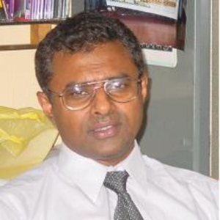
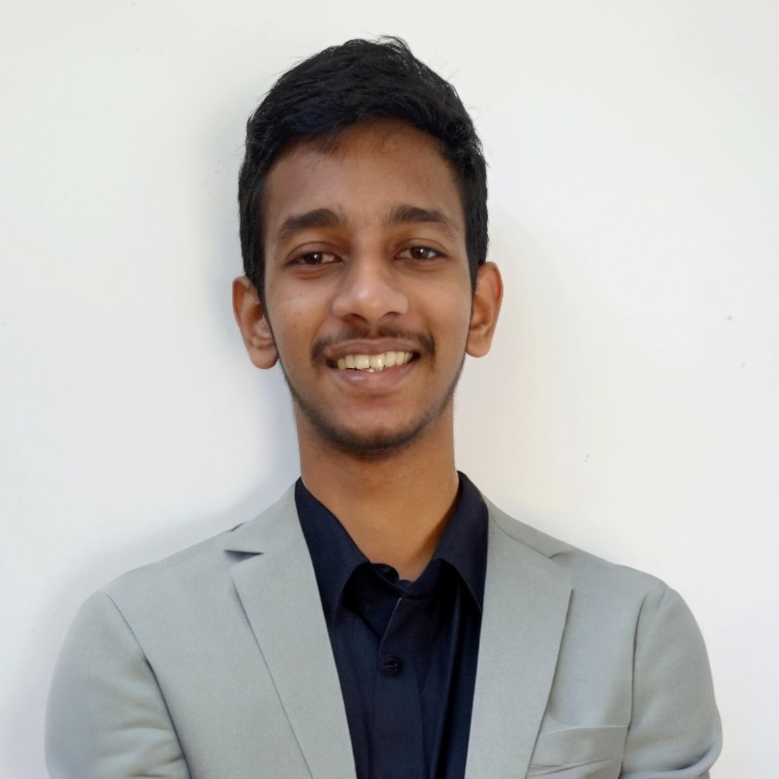
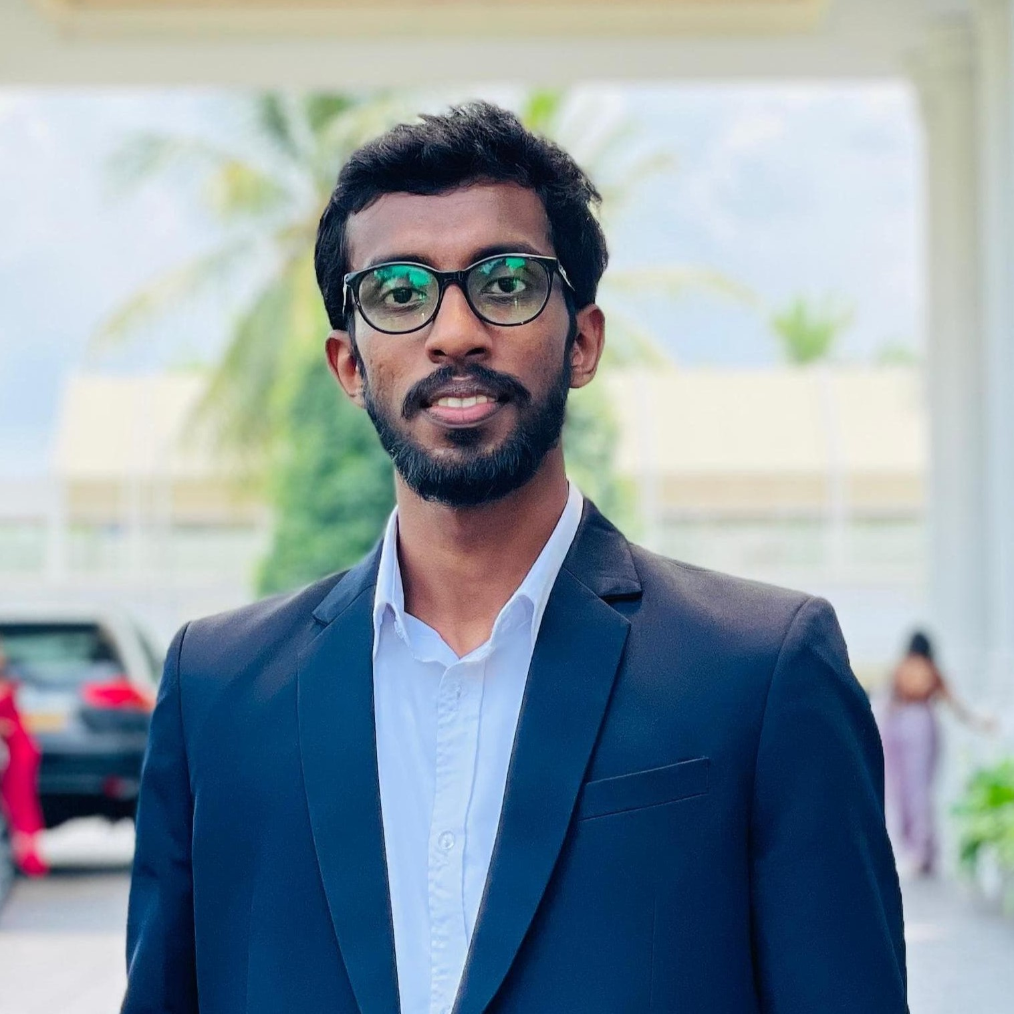
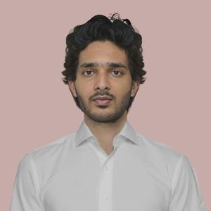
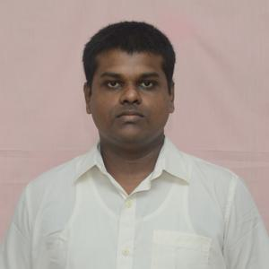
OUR TEAM
SUPERVISOR
Prof. Manjula Sandirigama
E/20/032
Bandara A.M.N.C.
E/20/035
Bandara K.C.H.N.A.W.M.R.C.J.N.
E/20/133 Haththella H.A.D.T.N.
E/20/157
Janakantha S.M.B.G.

Slide 8
e-Conductor

Slide 9
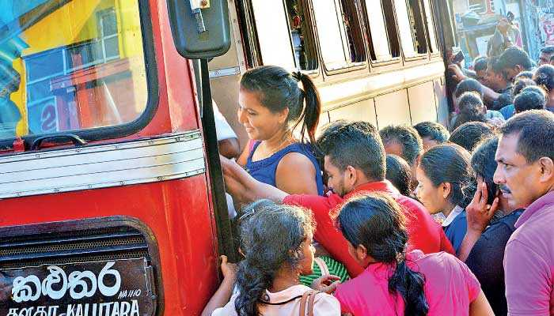
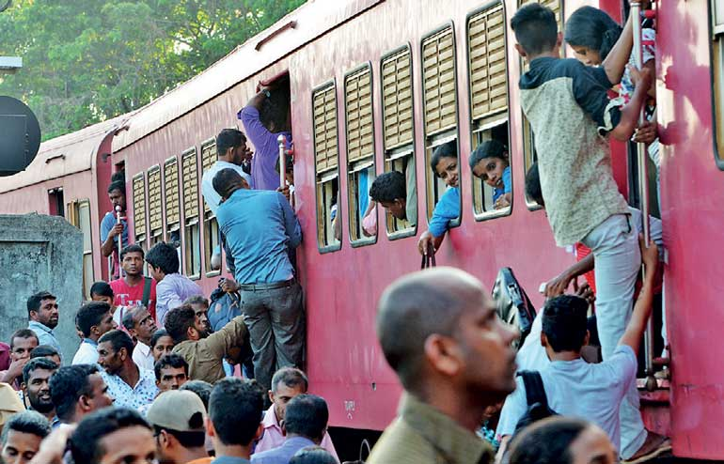
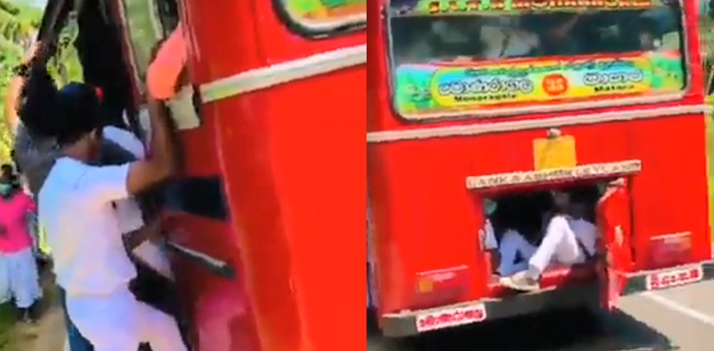
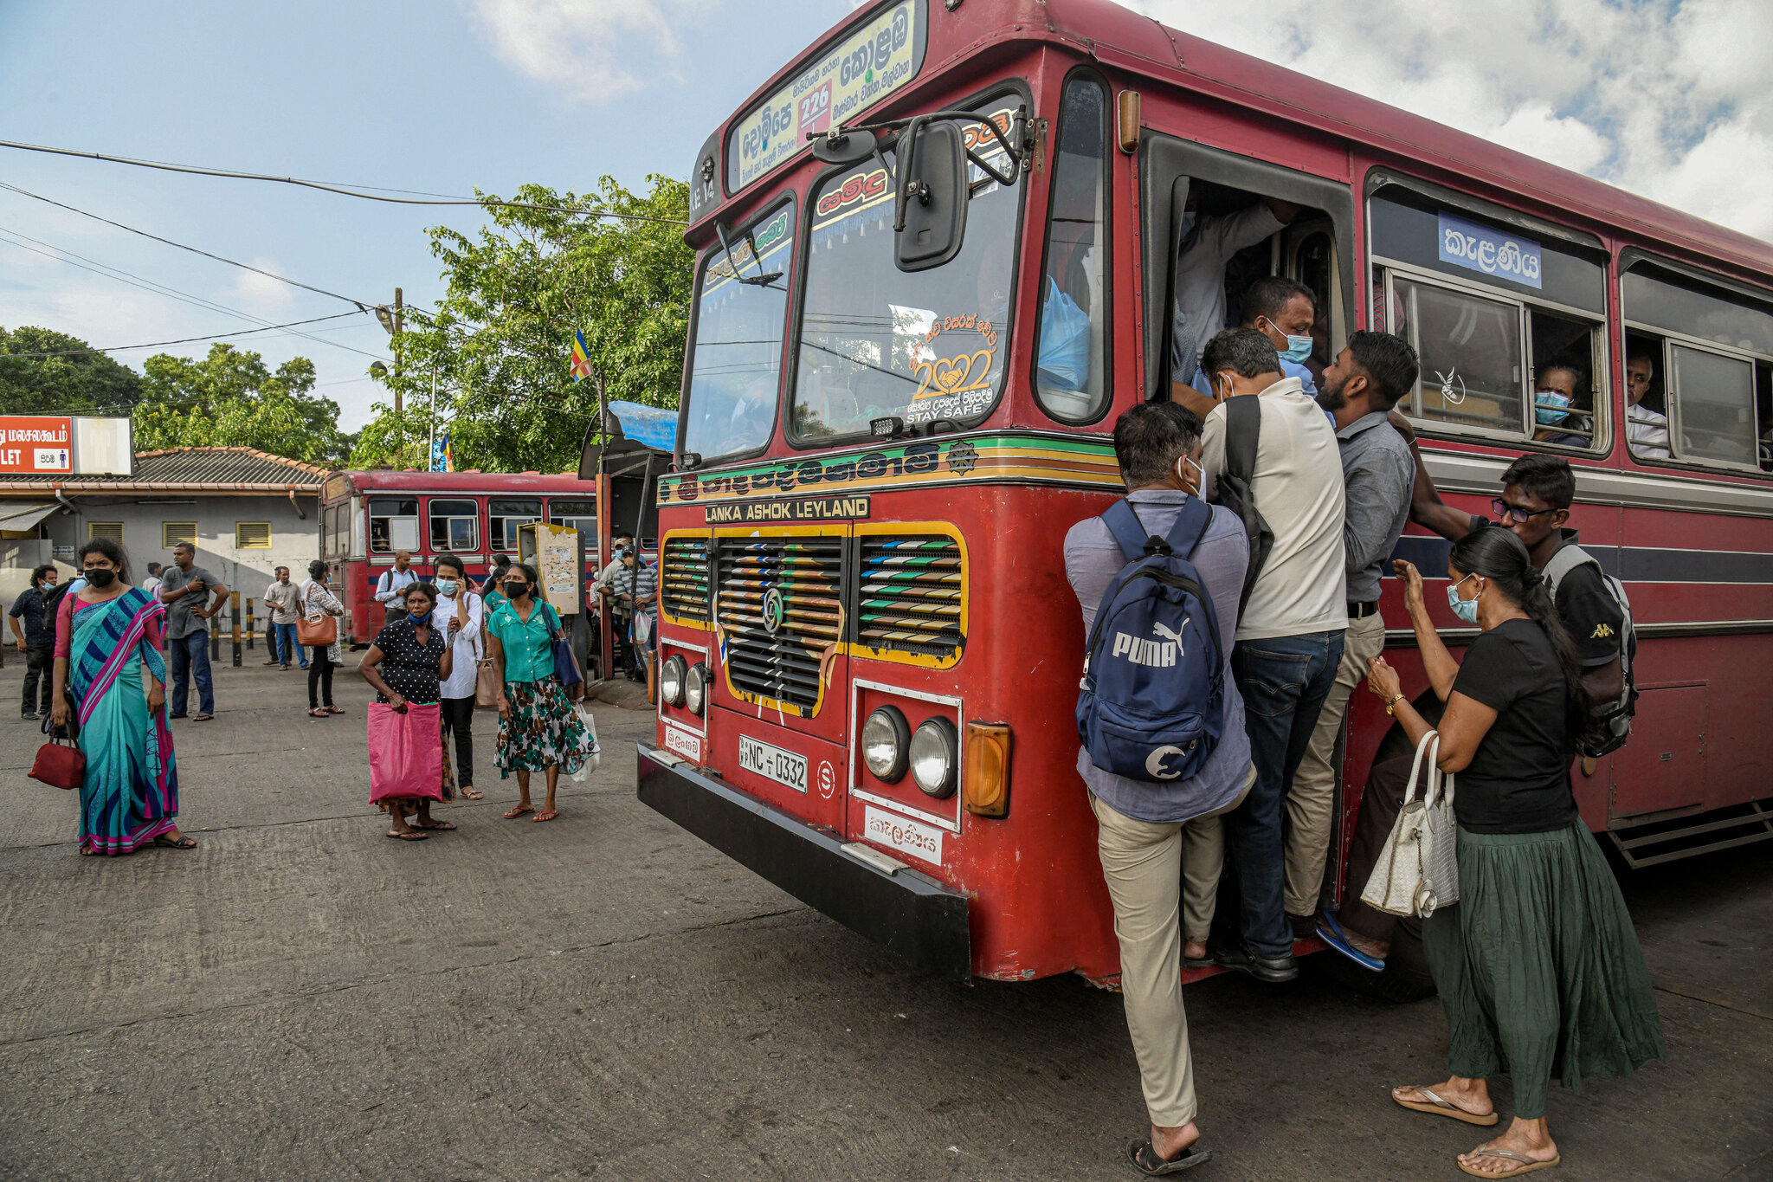
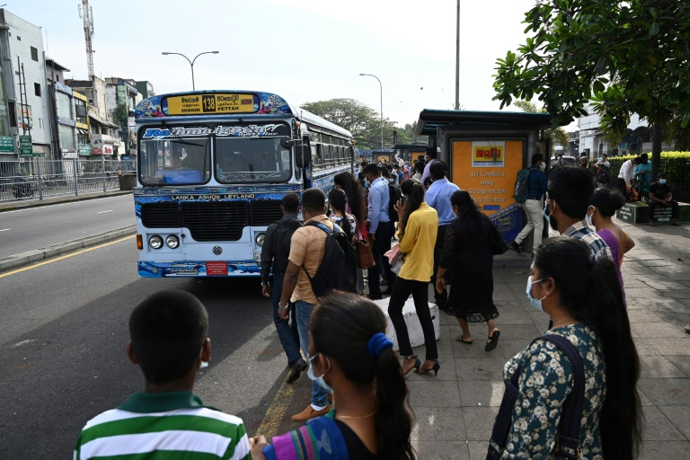
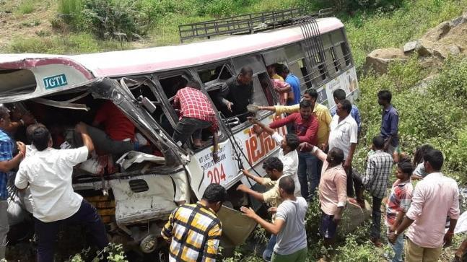
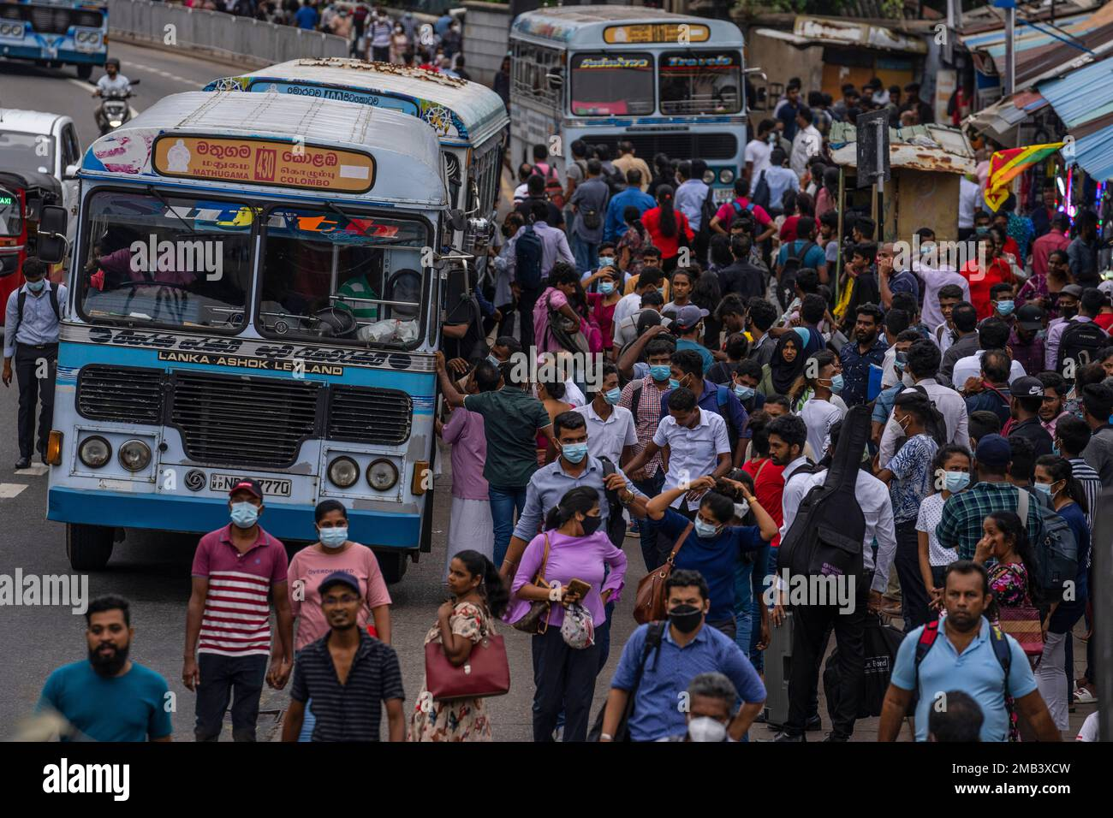



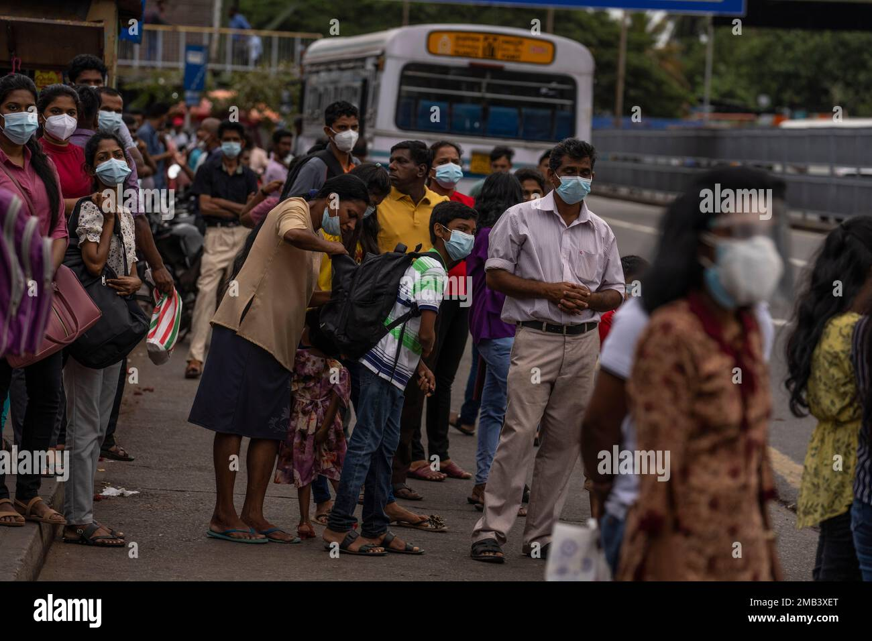
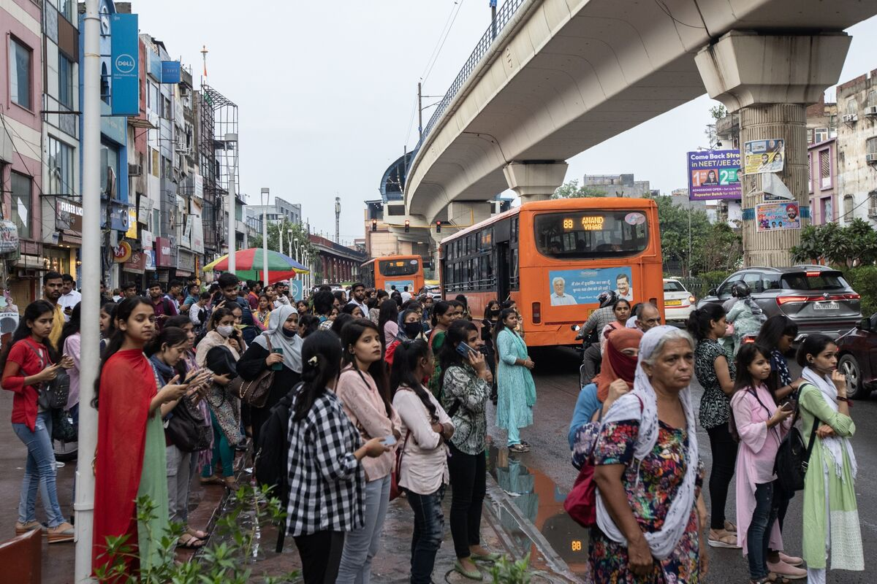
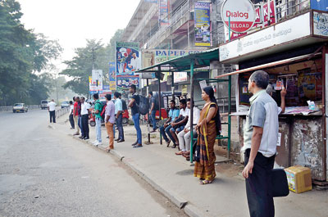
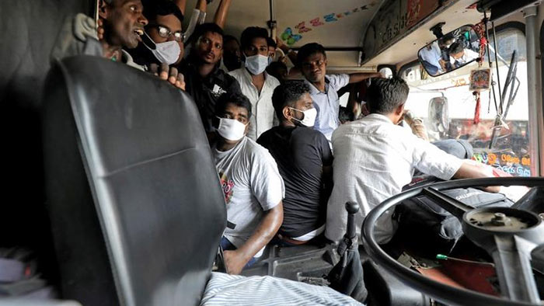



THE PROBLEM
Waiting in long queues
No method to find availability of busses
Overcrowded busses
Issues on getting balance
Shift to alternative methods

Slide 10
OUR TEAM
THE PROBLEM
EXISTING SOLUTIONS ?
OUR SOLUTION
OUR PLAN
e-Conductor

Slide 11
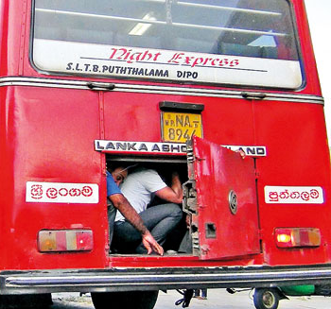
THE PROBLEM
Waiting in long queues
No method to find availability of busses
Overcrowded busses
Issues on getting balance
Shifting from public transport

Slide 12
SAMPLE TEXT
POINT 1
POINT 2
POINT 3
POINT 4
POINT 5

Slide 13
e-Conductor

Slide 14
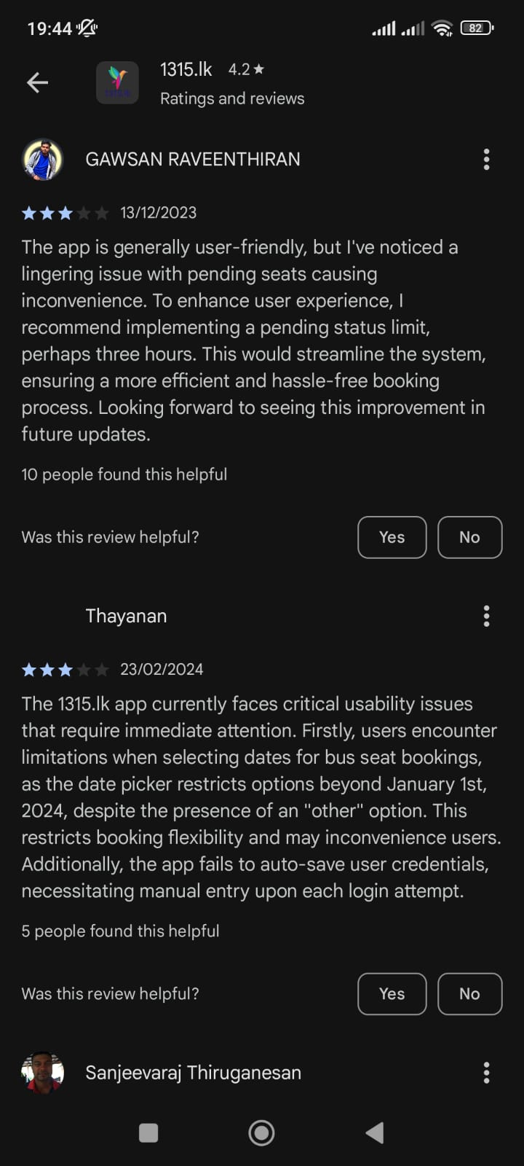
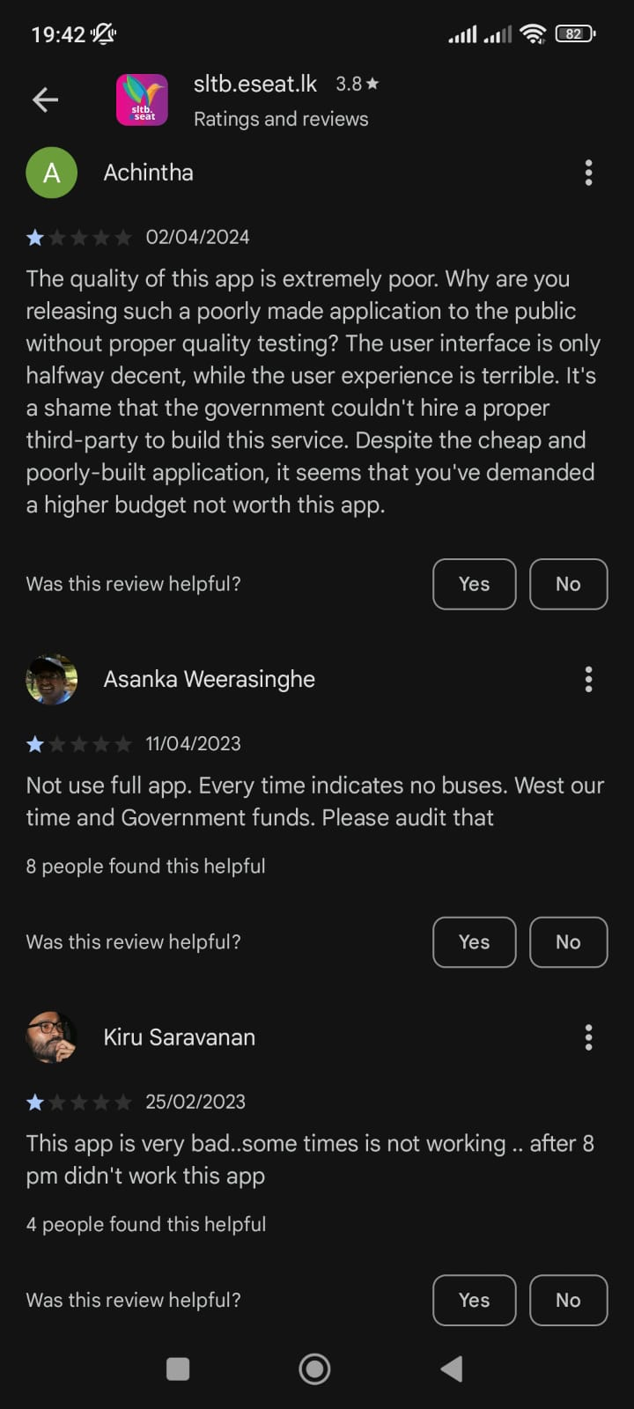
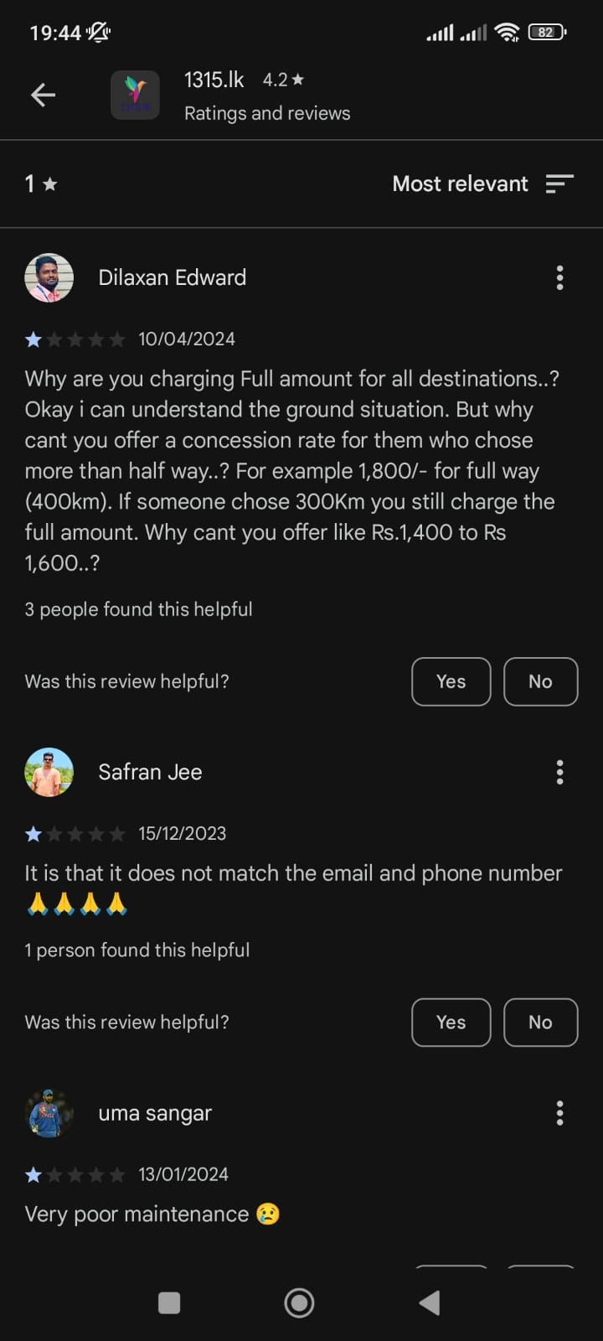
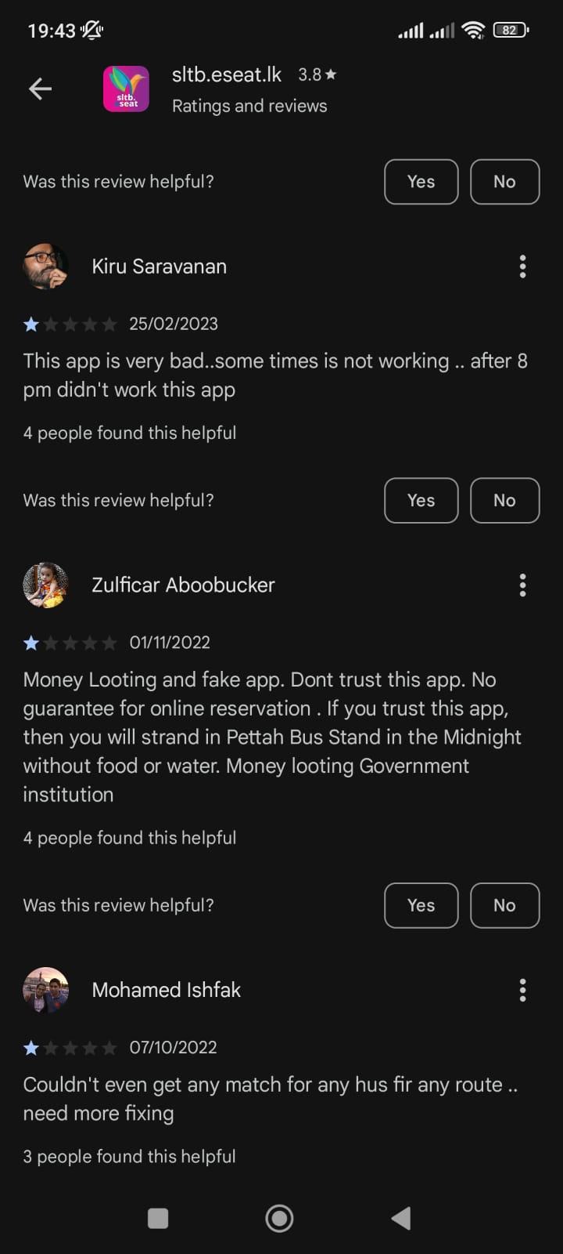
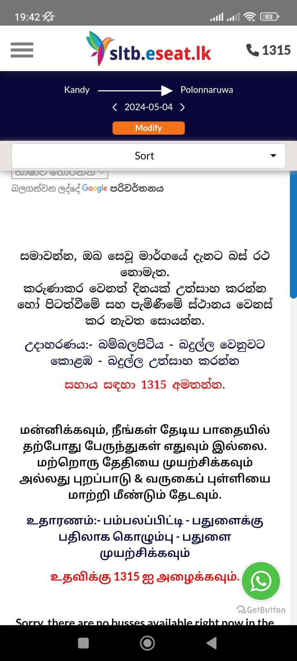
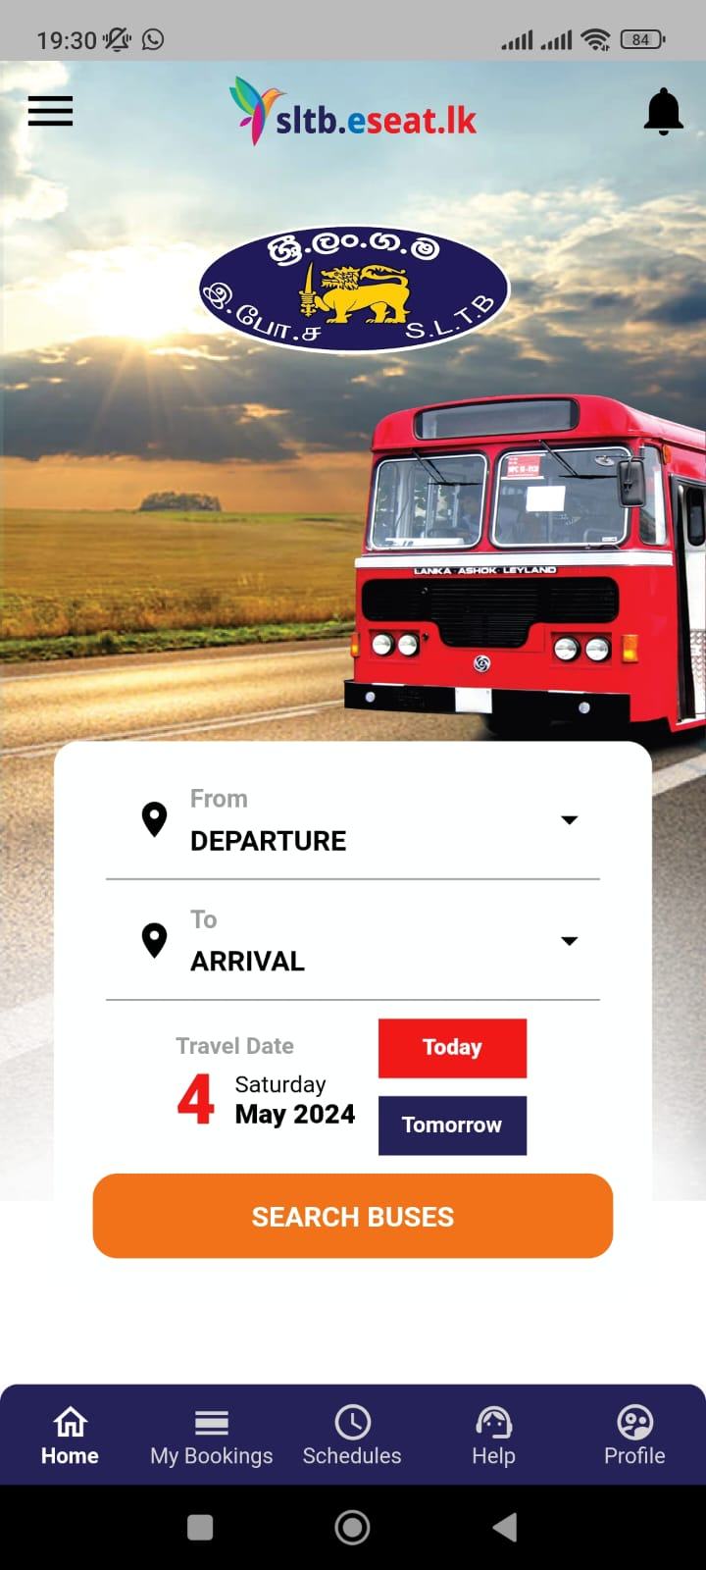
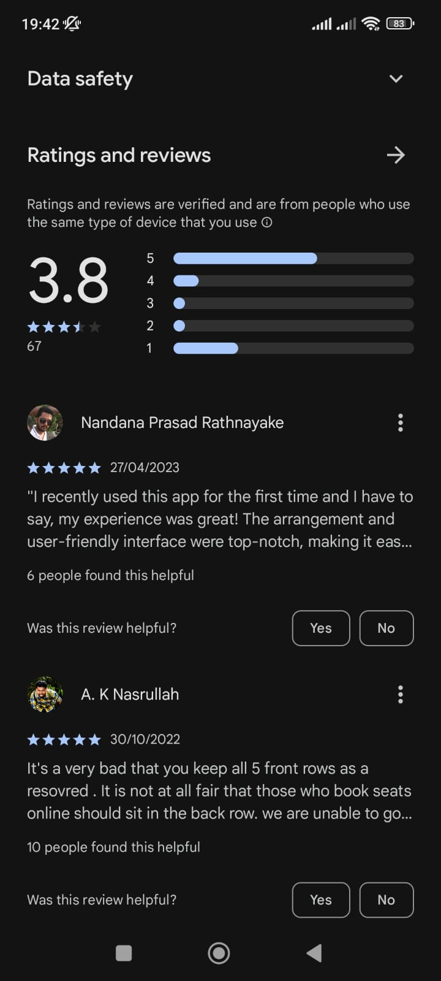




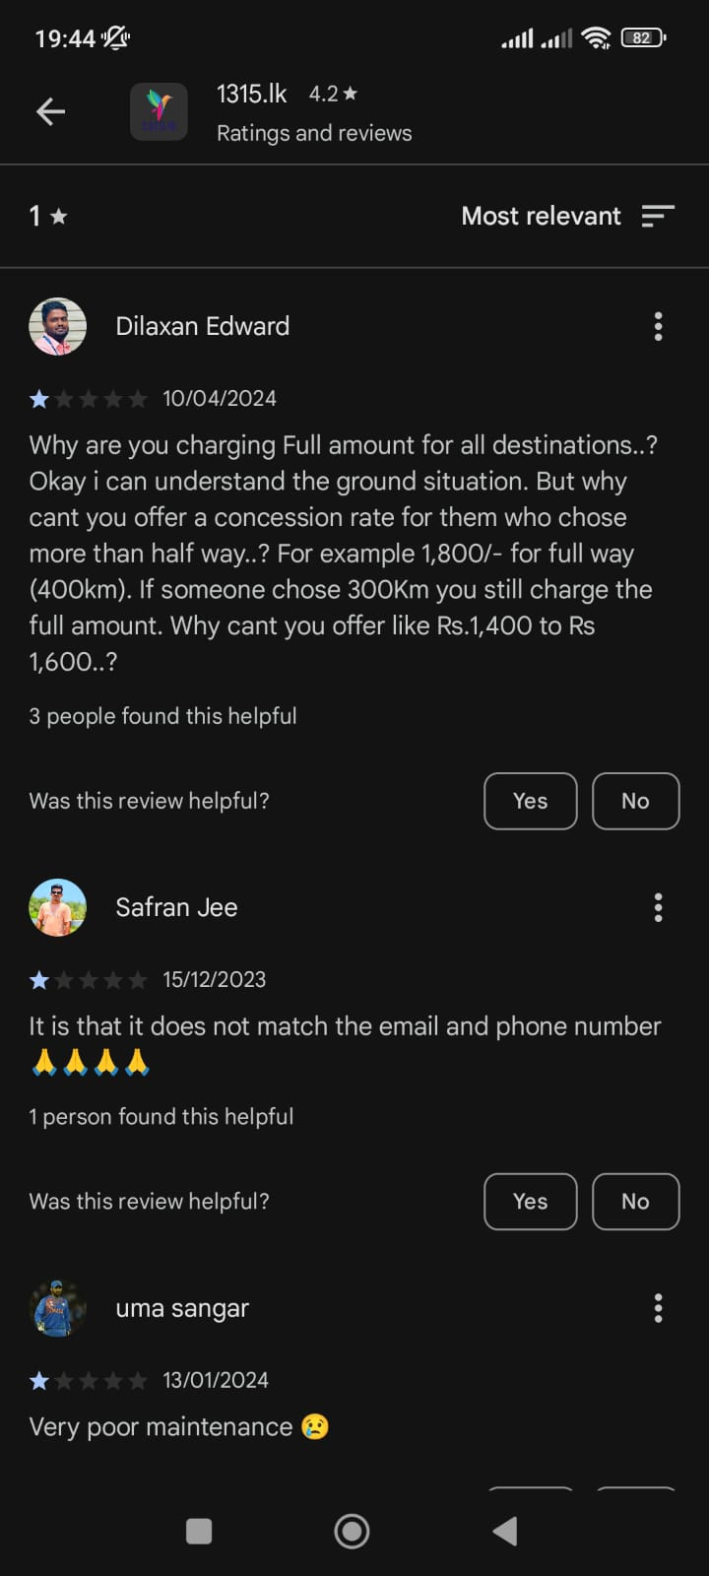
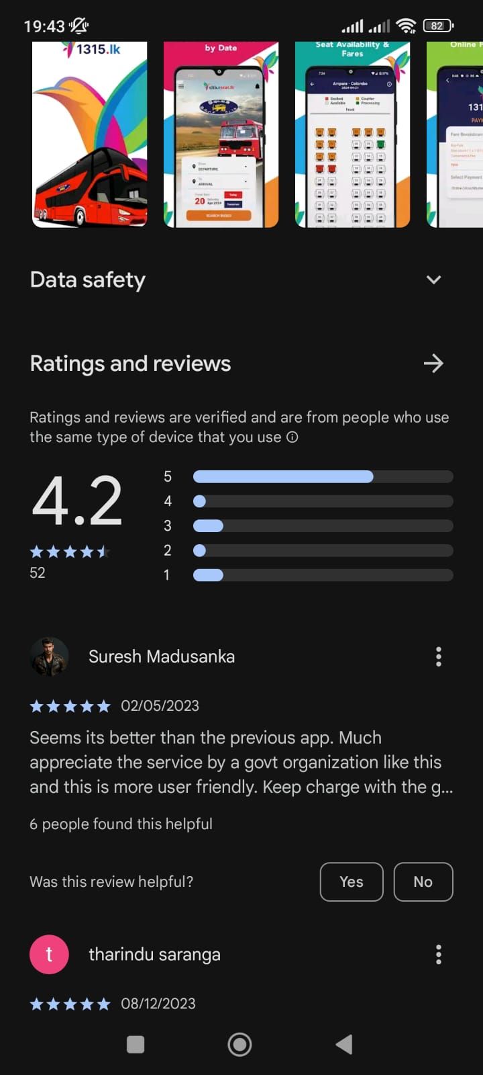
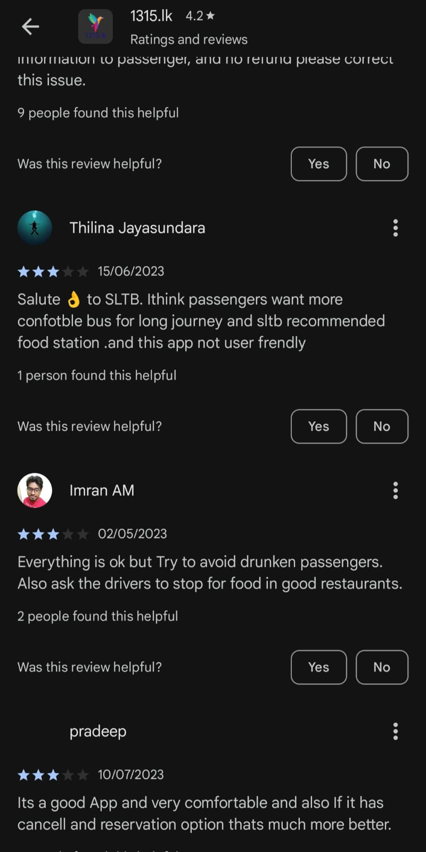

CURRENT SOLUTIONS
No method for tracking busses
Payment and booking are not guaranteed
Contact details are not available
Schedules are outdated
No Methods for complains

Slide 15
OUR TEAM
THE PROBLEM
EXISTING SOLUTIONS ?
OUR SOLUTION
OUR PLAN
e-Conductor

Slide 16
EXISTING SOLUTIONS ?
No method for tracking busses
Payment and booking are not guaranteed
Contact details are not available
Schedules are outdated
No Methods for complaints

Slide 17
OUR TEAM
THE PROBLEM
EXISTING SOLUTIONS ?
OUR SOLUTION
OUR PLAN
e-Conductor

Slide 18





OUR SOLUTION
Online seat reservation facility
Online schedule checking facility
Realtime location tracking facility
Digital transaction facility
Customer care service

Slide 19
OUR TEAM
THE PROBLEM
EXISTING SOLUTIONS ?
OUR SOLUTION
OUR PLAN
e-Conductor

Slide 20







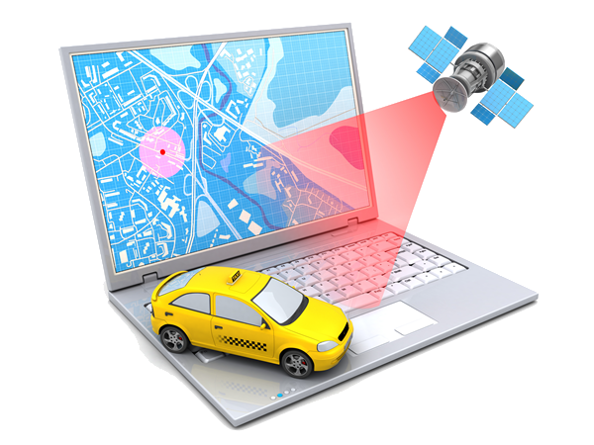
OUR PLAN
Web App
Mobile App
Database
Testing & Debugging
Payment Gateway
App Launching
Suggestion Algorithm
Live Location Tracking
Notes:
Further implementation: Extend to normal routes, Merge train App

Slide 21
OUR PLAN
Web App
Mobile App
Database
Testing & Debugging
Payment Gateway
App Launching
Fastest Path Algorithm
Live Location Tracking

Slide 22
OUR TEAM
THE PROBLEM
EXISTING SOLUTIONS ?
OUR SOLUTION
OUR PLAN
e-Conductor

Slide 23
THANK YOU

Slide 24
Thank you!
Thank you!

